Slide 1

THE NATIONAL INSTITUTE OF ENGINEERING (An Autonomous Institute under VTU, Belagavi) Operating Systems(CS5C02) Submitted by TANMAY KUMAR 4NI19CS114 YASH CHAUHAN 4NI19CS123 Course Instructor: Dr. Jayasri B S (Professor and Dean- EAB)

Slide 2
ROUND ROBIN SCHEDULING
Contents:
Description
Algorithm
Implementation and Output
Advantages
Disadvantages

Slide 3
Description:
A Round-Robin scheduling algorithm is used to schedule the process fairly for each job a time slot or quantum and the interrupting the job if it is not completed by then the job come after the other job which is arrived in the quantum time that makes these scheduling fairly.

Slide 4
Algorithm:
Step 1: Organize all processes according to their arrival time in the ready queue. The queue structure of the ready queue is based on the FIFO structure to execute all CPU processes.
Step 2: Now, we push the first process from the ready queue to execute its task for a fixed time, allocated by each process that arrives in the queue.
Step 3: If the process cannot complete their task within defined time interval or slots because it is stopped by another process that pushes from the ready queue to execute their task due to arrival time of the next process is reached. Therefore, CPU saved the previous state of the process, which helps to resume from the point where it is interrupted. (If the burst time of the process is left, push the process end of the ready queue).
Step 4: Similarly, the scheduler selects another process from the ready queue to execute its tasks. When a process finishes its task within time slots, the process will not go for further execution because the process's burst time is finished.
Step 5: Similarly, we repeat all the steps to execute the process until the work has finished.

Slide 5
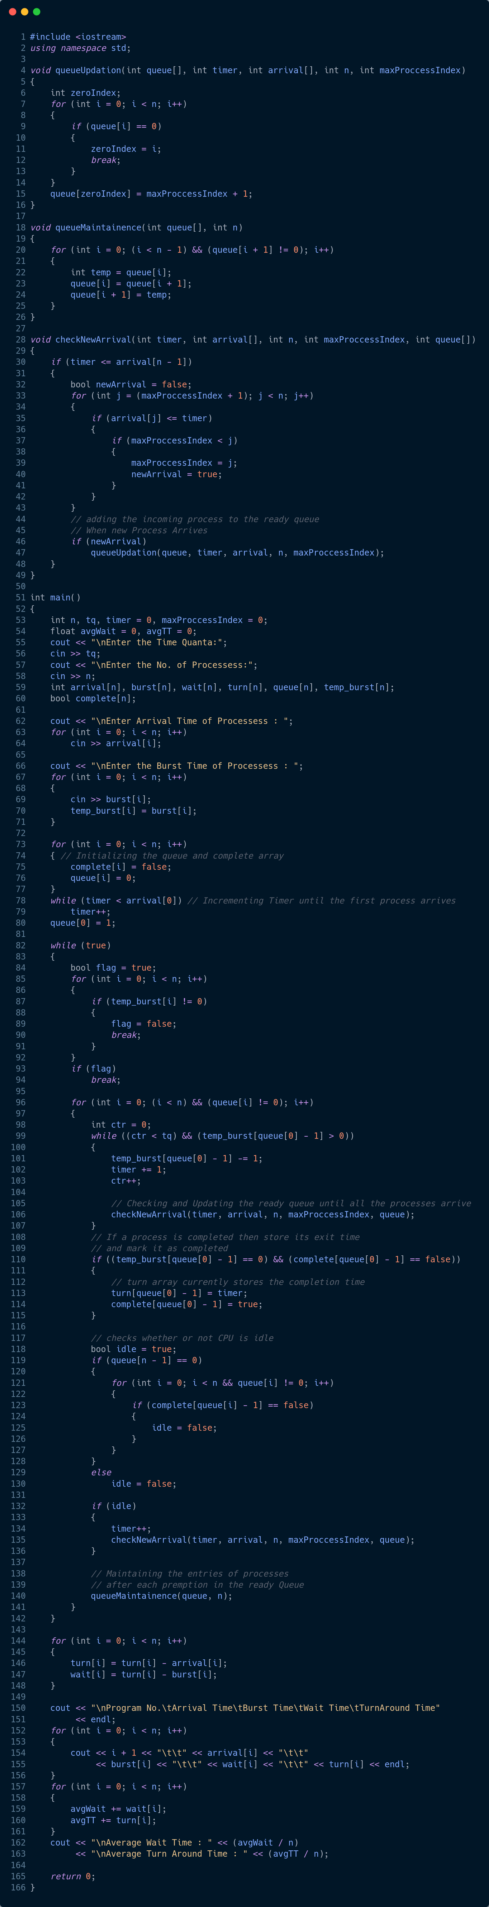
Implementation:

Slide 11
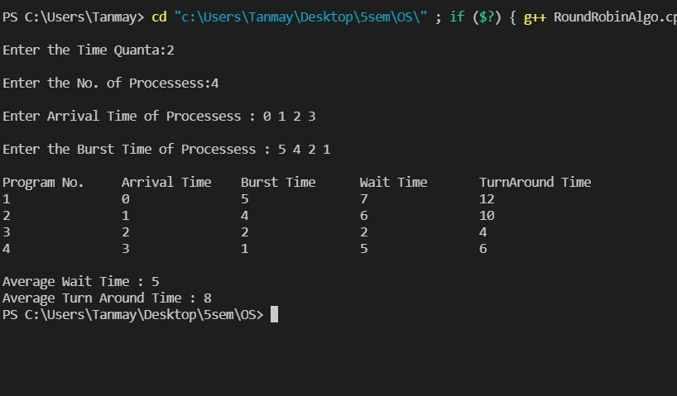
Output:

Slide 12
Advantages:
It does not face any starvation issues or convoy effect.
Each process gets equal priority to the fair allocation of CPU.
It is easy to implement the CPU Scheduling algorithm.
Each new process is added to the end of the ready queue as the next process's arrival time is reached.
Each process is executed in circular order that shares a fixed time slot or quantum.
Every process gets an opportunity in the round-robin scheduling algorithm to reschedule after a given quantum period.

Slide 13
Disadvantages:
If the time quantum is lower, it takes more time on context switching between the processes.
It does not provide any special priority to execute the most important process.
The waiting time of a large process is higher due to the short time slot.
The performance of the algorithm depends on the time quantum.
The response time of the process is higher due to large slices to time quantum.
Getting a correct time slot or quantum is quite difficult for all processes in the round-robin algorithm

Slide 14
Least Recently Used Page Replacement Algorithm
Contents:
Description
Algorithm
Implementation and Output
Advantages
Disadvantages

Slide 15
Description:
The Least Recently Used (LRU) page replacement policy replaces the page that has not been used for the longest period of time. It is one of the algorithms that were made to approximate, if not better the efficiency of the optimal page replacement algorithm. The optimal algorithm assumes the entire reference string to be present at the time of allocation and replaces the page that will not be used for the longest period of time. LRU page replacement policy is based on the observation that pages that have been heavily used in the last few instructions will probably be heavily used again in the next few. Conversely, pages that have not been used for ages will probably remain unused for a long time.

Slide 16
Algorithm:
Let pages_num be the number of pages that memory can hold. Let frame array be the current set of pages in memory.
1.Start traversing the pages.
i) If frame array holds less pages than pages_num.
1) Insert page into the frame array one by one until the size of frame array reaches capacity or all page requests are processed.
2) Simultaneously maintain the recent occurred index of each page in a array called fcount.
3) Increment count.
ii) Else If current page is present in frame array, do nothing.

Slide 17
Algorithm:
iii) Else
1) Find the page in the frame array that was least recently used. We find it using fcount array. We basically need to replace the page with minimum index.
2) Replace the found page with current page.
3) Increment count.
4) Update index of current page in fcount.
2.Calculate number of hits, hit ratio, miss ratio as follows,
Number of hits=pages_num-count.
Hit ratio= (Number of hits/pages_num) *100
Miss ratio= (Count/pages_num) *100

Slide 18
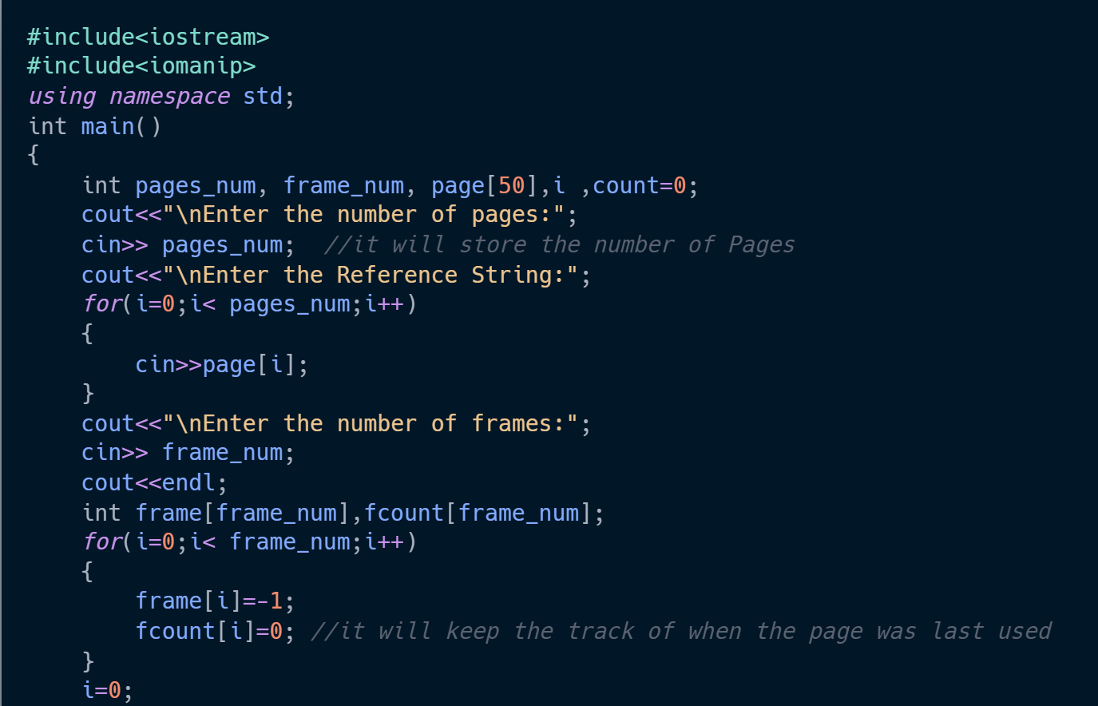
Implementation:

Slide 19
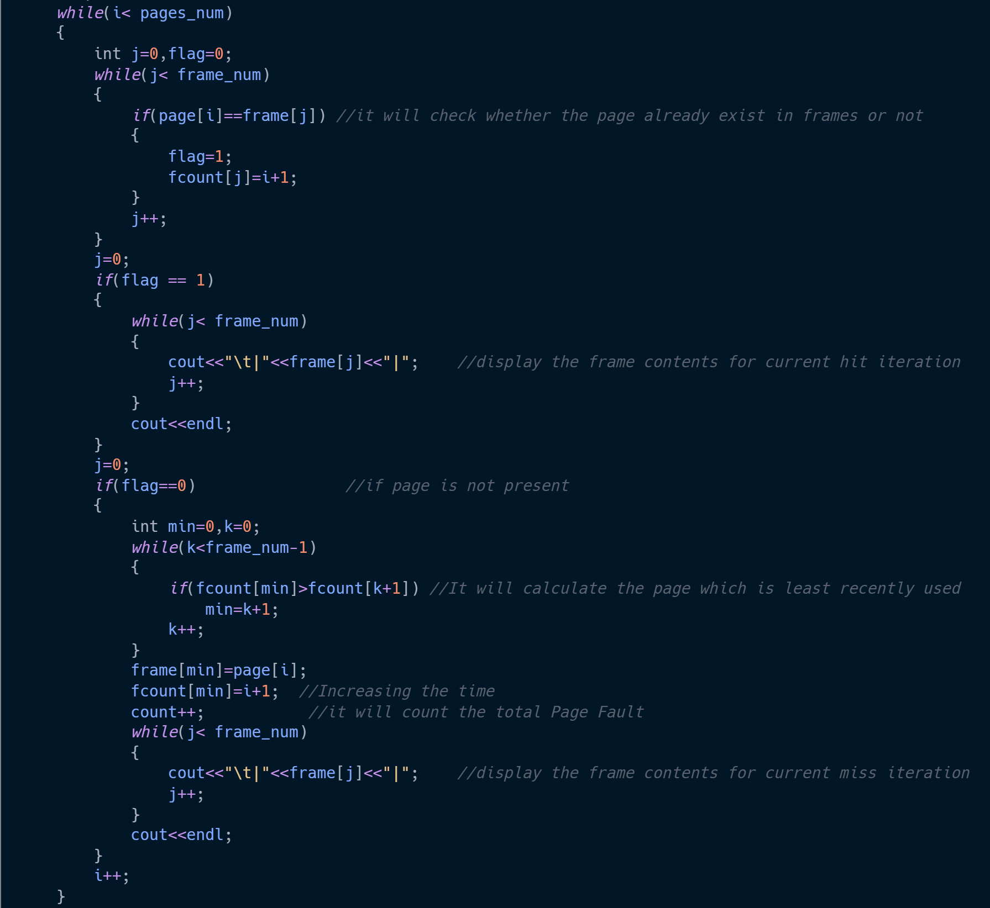

Slide 20
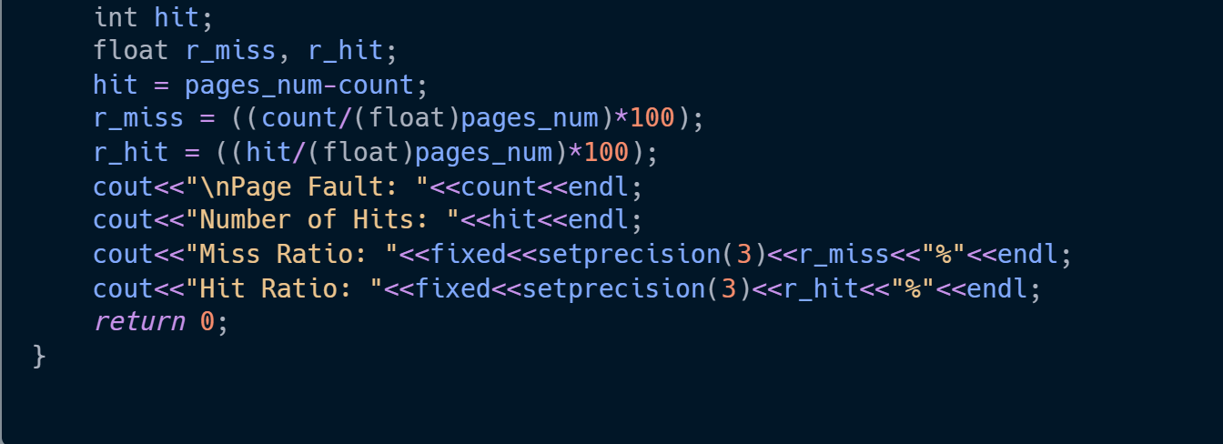
Implementation:

Slide 21
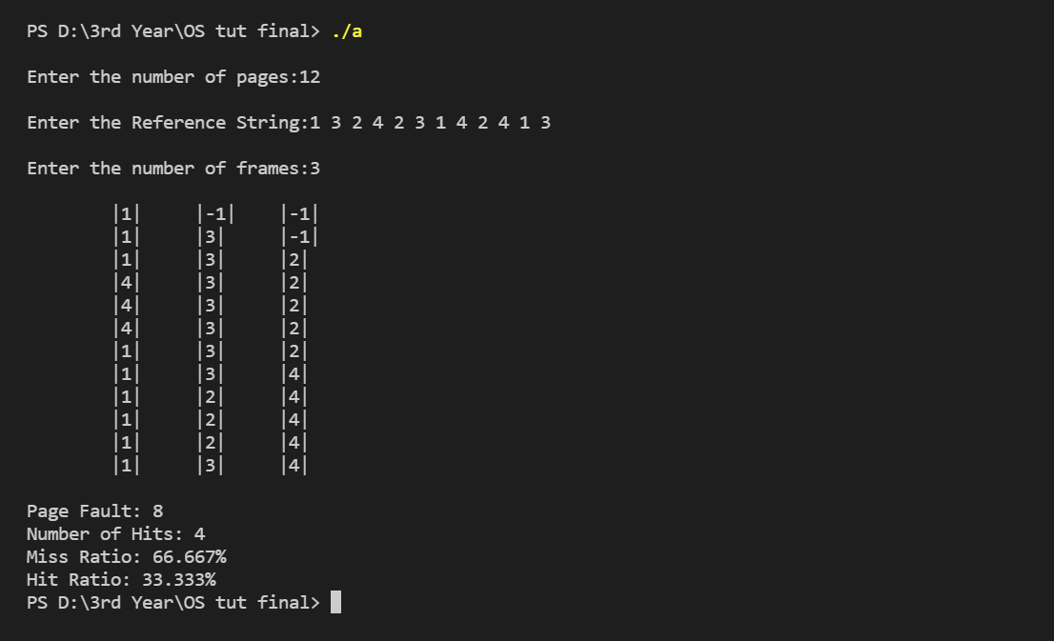
Output:

Slide 22
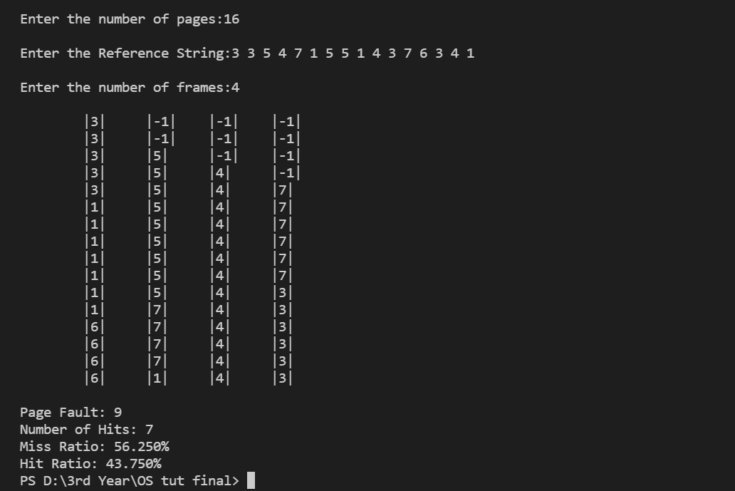
Output:

Slide 23
Advantages:
LRU doesn't suffer from Belady's Anomaly.
The page in the main memory that hasn't been used in the longest will be chosen for replacement.
It generally gives fewer page faults than any other page replacement algorithm. So, LRU is the most commonly utilized method.
It helps in the full analysis.

Slide 24
Disadvantages:
It is not easy to implement LRU because it requires hardware assistance.
It is expensive and more complex.
It needs an additional data structure.

Slide 25
THANK YOU..!!

